Slide 1
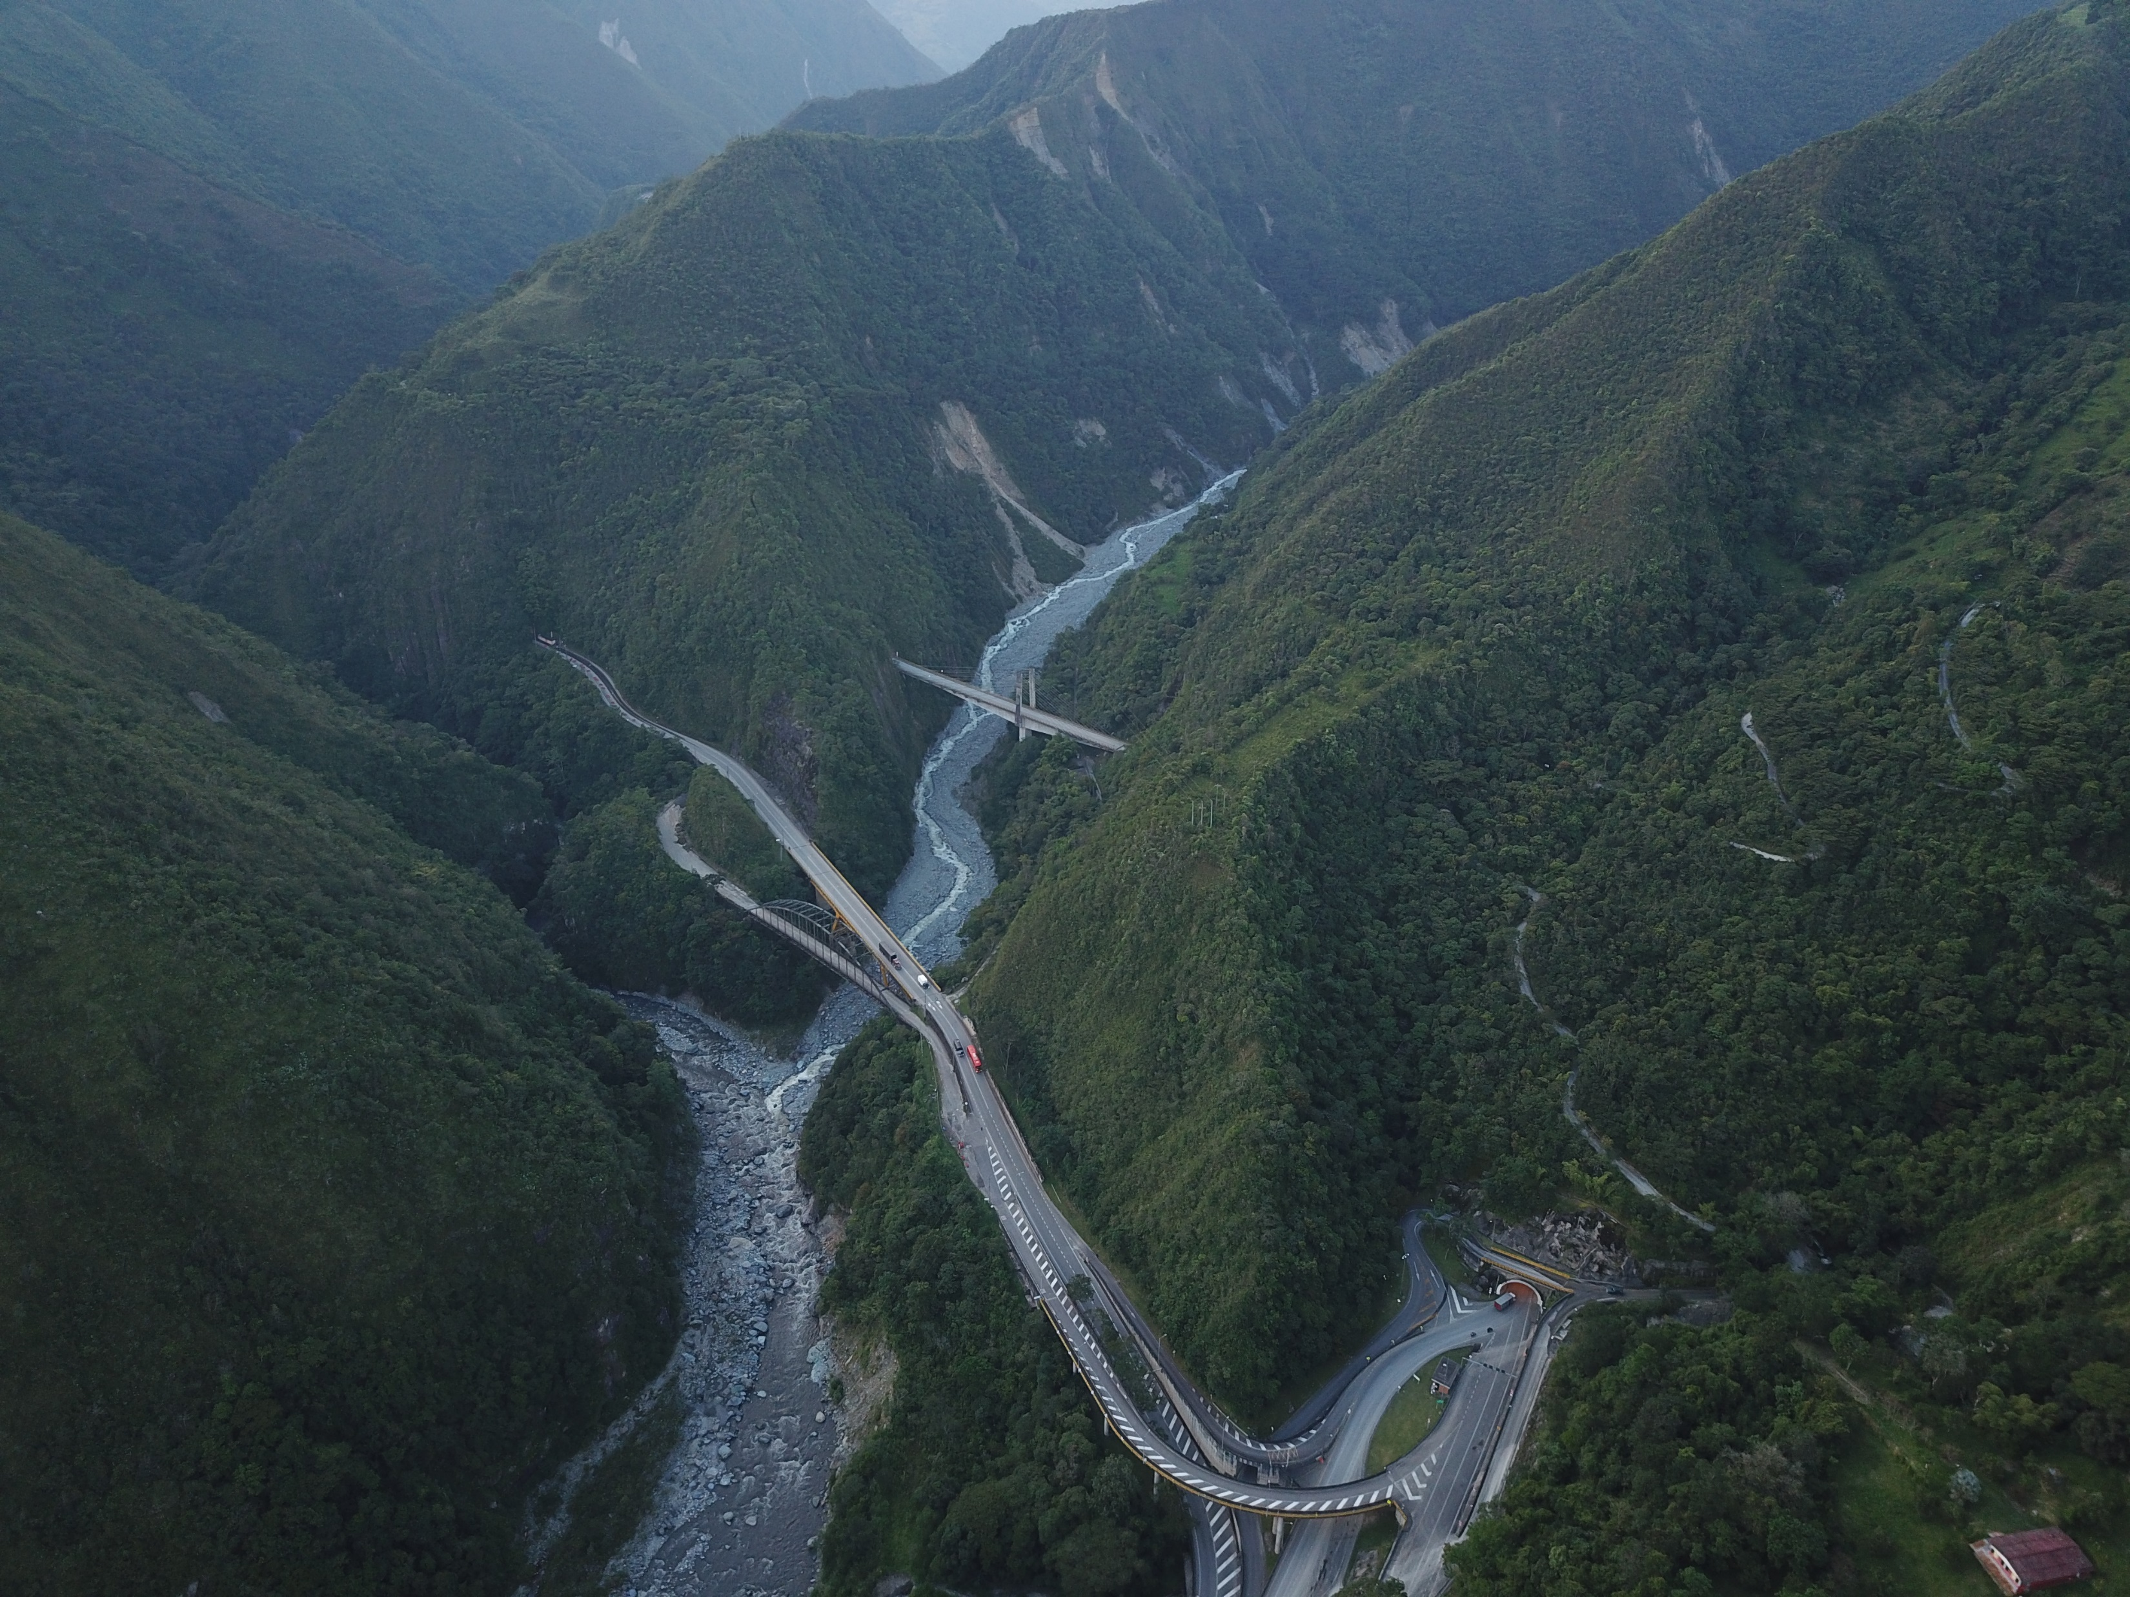
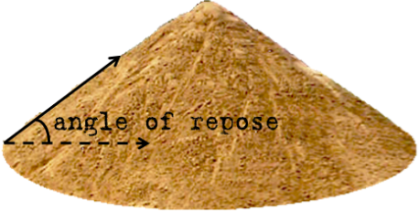
Wikipedia
Slope cannot get steeper
River can still steepen
Rivers better capture tectonics, geology, climate in steep landscapes

Slide 2
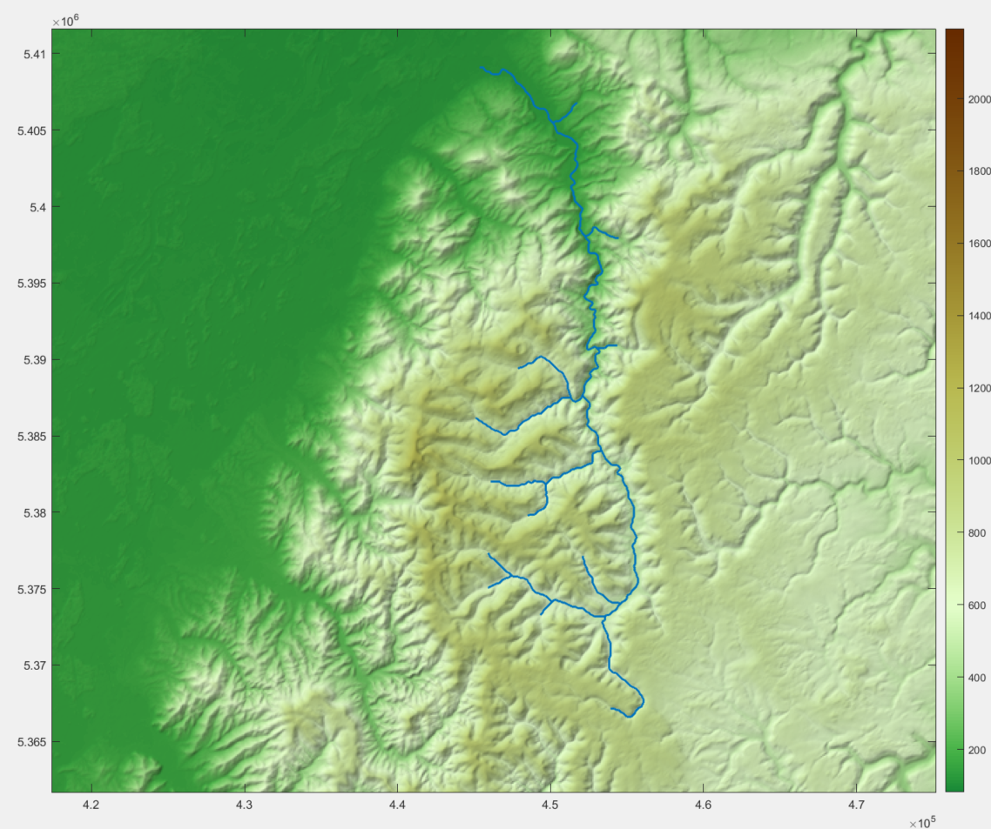
Basement rock geology
Doesn’t cross obvious active faults
Change in profile likely related to rate of base level fall at outlet = fault uplift

Slide 3
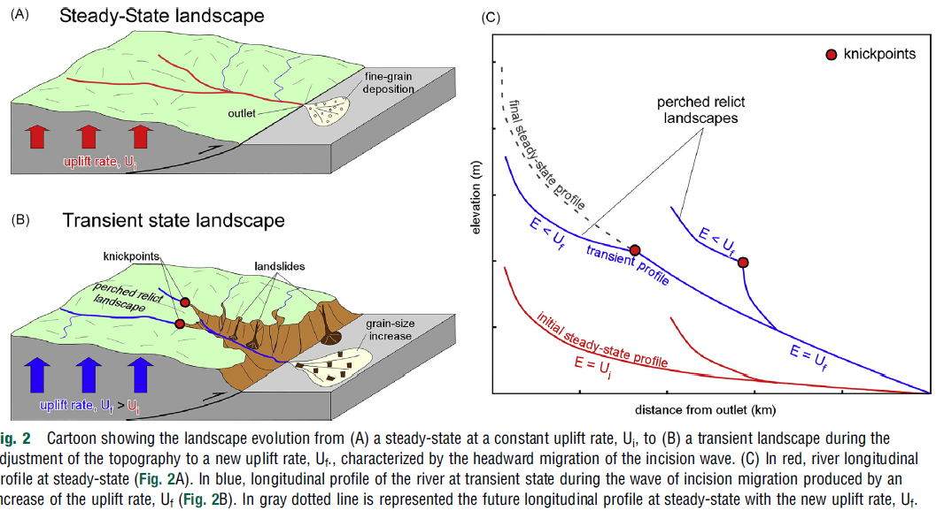
Struth et al. 2022, ToG

